Slide 1

Igishushanyo ca Baruki Spinoza kivugwa ko cakozwe na Samweli van Hoogstraten

Slide 2

Igishushanyo ca Baruki Spinoza

Slide 3

Insiguro y’“Inyifato runtu” ya Spinoza mu kilatini

Slide 4

Spinoza, “Igitabo c’Ivy’Imana n’Ivya Politike”, 1675

Slide 5

Igishushanyo ca Satoshi Nakamoto cakozwe na Gergely, R., na Gilly, T. (2021). Ibarabara ry'ibishushanyo, i Budapest, muri Hongiriya

Slide 6


Igishushanyo kigaragaza ukuntu Spinoza yakuwe mu muryango w’Abayuda wo muri Amsterdam
Ikidodo cakoreshejwe na Baruki Spinoza

Slide 7



Nikola Koperinik
Galilée Galilée
Yohani Kepleri

Slide 8

Gottfried Wilhelm Leibniz
Imanweli Kanti
Arthur umunyamideri
Fridriki Nitische

Slide 9

Deni Dideroti
Voltaire
Jean-Jac Rousseau

Slide 10

Voltaire

Slide 11

Galilée Galilée

Slide 12

Spinoza, “Inyifato runtu”

Slide 13

Spinoza, “Igitabo c’Ivya Tewolojiya n’Ivya Politike”

Slide 14

Gili Deluzi

Slide 15

Spinoza, “Igitabo c’Ivya Tewolojiya n’Ivya Politike”

Slide 16

“Inyifato runtu”, Igice ca mbere, “Ivyerekeye Imana”

Slide 17

Igishushanyo ca William Blake, “Imana irema Isanzure ry’Ijuru”

Slide 18

Umutingito wo i Lisbonne, mu 1755

Slide 19

Gottfried Wihelm Leibniz

Slide 20

Jean-Jac Rousseau

Slide 21


Nikola Koperini
Saroli Daruwini

Slide 22

Ikarata y'Uburaruko, mu kinjana ca 19

Slide 23



Galilée Galilée
Izahaki Nyutoni
Alberti Eyinishiteni

Slide 24

Rene Desikate

Slide 25

René Descartes, “Insiguro yerekeye Uburyo”

Slide 26

Igishushanyo ca Descartes

Slide 27

Niyumvira, rero ndi
Dekariti

Slide 28

Umugereka w’igice ca mbere c’igitabu ca Spinoza citwa “Inyifato runtu”

Slide 29

Emanweli Kanti

Slide 30

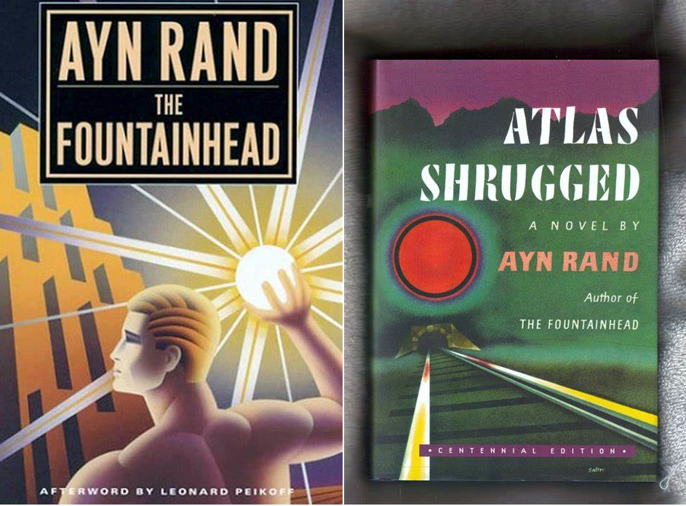
Ayn Rand
Umutwe w'Isoko
Atlas yavyura intugu

Slide 31

Spinoza, “Inyifato runtu”, Igice ca gatatu

Slide 32
Nikola Koperinik
Galilée Galilée
Yohani Kepleri

Slide 33

Jean-Batista Lamarck

Slide 34

Jorji Kuvier

Slide 35

F.A.Hayek, “Inzira ija mu Buja”

Slide 36
Insiguro y'inyifato runtu ya Spinoza mu kilatini

Slide 37
Igishushanyo ca William Blake, “Imana irema Isanzure ry’Ijuru”

Slide 38

Gili Deluze

Slide 39

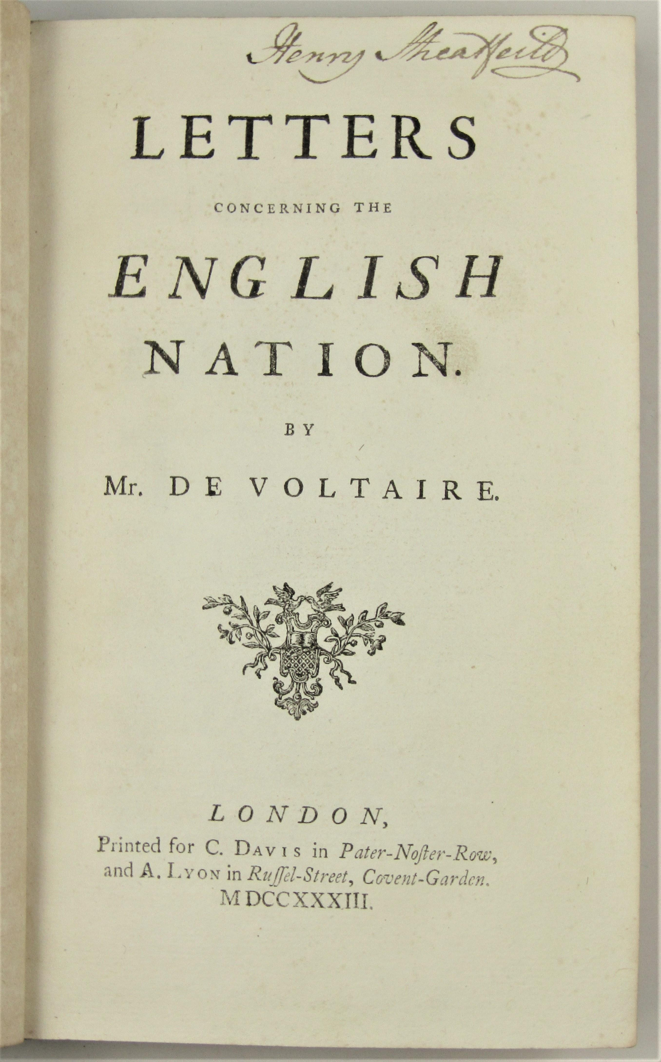
Voltaire, “Amakete yava mu Bwongereza”

Slide 40

Anicet Charles Gabriel Lemonnier, “Inzu y’isuku ya Madamu Geoffrin”, mu kinjana ca 18

Slide 41

Intangamarara y’igitabu ca Spinoza citwa “Igitabu c’ivy’Imana n’ivya politike”

Slide 42

Igishushanyo ca Sokarate

Slide 43

Igishushanyo ca Augustin mweranda cakozwe na Sandro Botticelli, mu 1480

Slide 44

Spinoza, “Inyifato runtu”, Igice ca 3

Slide 45
Gili Deluzi

Slide 46

Spinoza, “Inyifato runtu”

Slide 47

Intangamarara y'igitabu ca Spinoza kivuga ivy'Imana n'ivya politike

Slide 48

Iterambere rya Bitcoin

Slide 49

Igishushanyo ca Yupiteri

Slide 50
Insiguro y'inyifato runtu ya Spinoza mu kilatini

Slide 51


Fridriki Nitische
Igishushanyo ca Rousseau i Genève

Slide 52

Fridiriki kuri Hayek

Slide 53

Frederiki Bastiyati

Slide 54

Militoni Fridimani

Slide 55

“Ikete ry’abanyagihugu b’abanyagitugu” be n’“Ikete ry’abanyagihugu b’abanyagihugu”

Slide 56

Bitcoin Itanguriro ry'Ibuye

